Slide 1
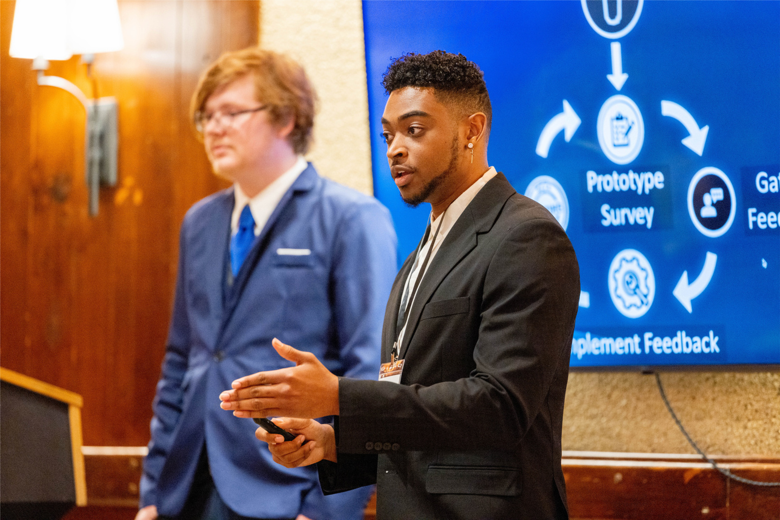
IGNITEWV
2023-24

Slide 2
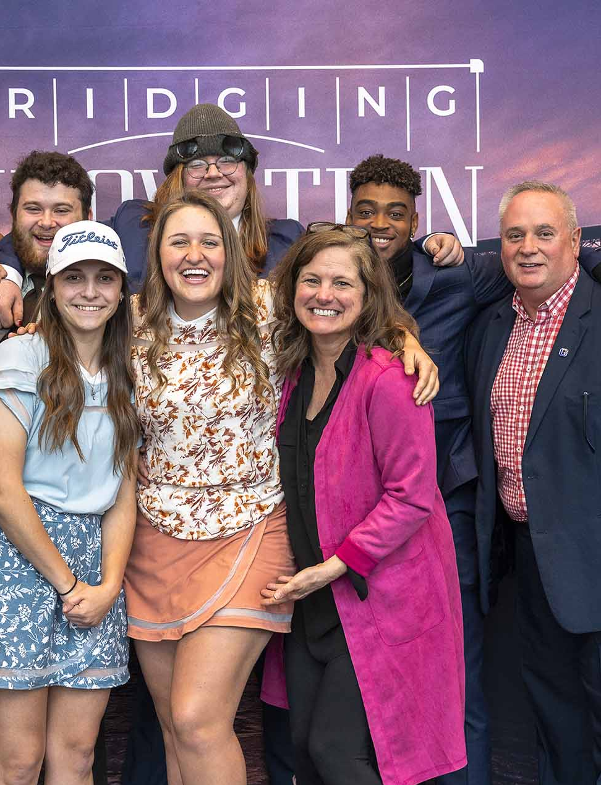
COMPETITION GOALS
Provide budding entrepreneurs with the education, skills, contacts, and funds necessary to create a viable start-up or scale a company in West Virginia.
Award $100,000+ in technical assistance funds
IGNITEWV

Slide 3
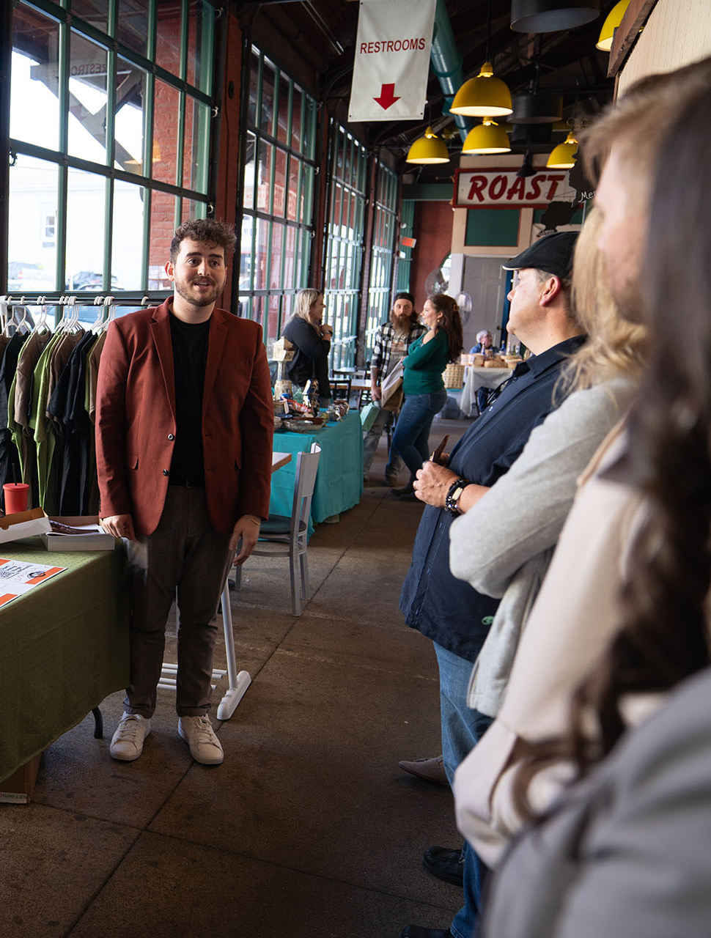
ELIGIBILITY
Open to anyone 18+
Must register for business in WV
IGNITEWV

Slide 4
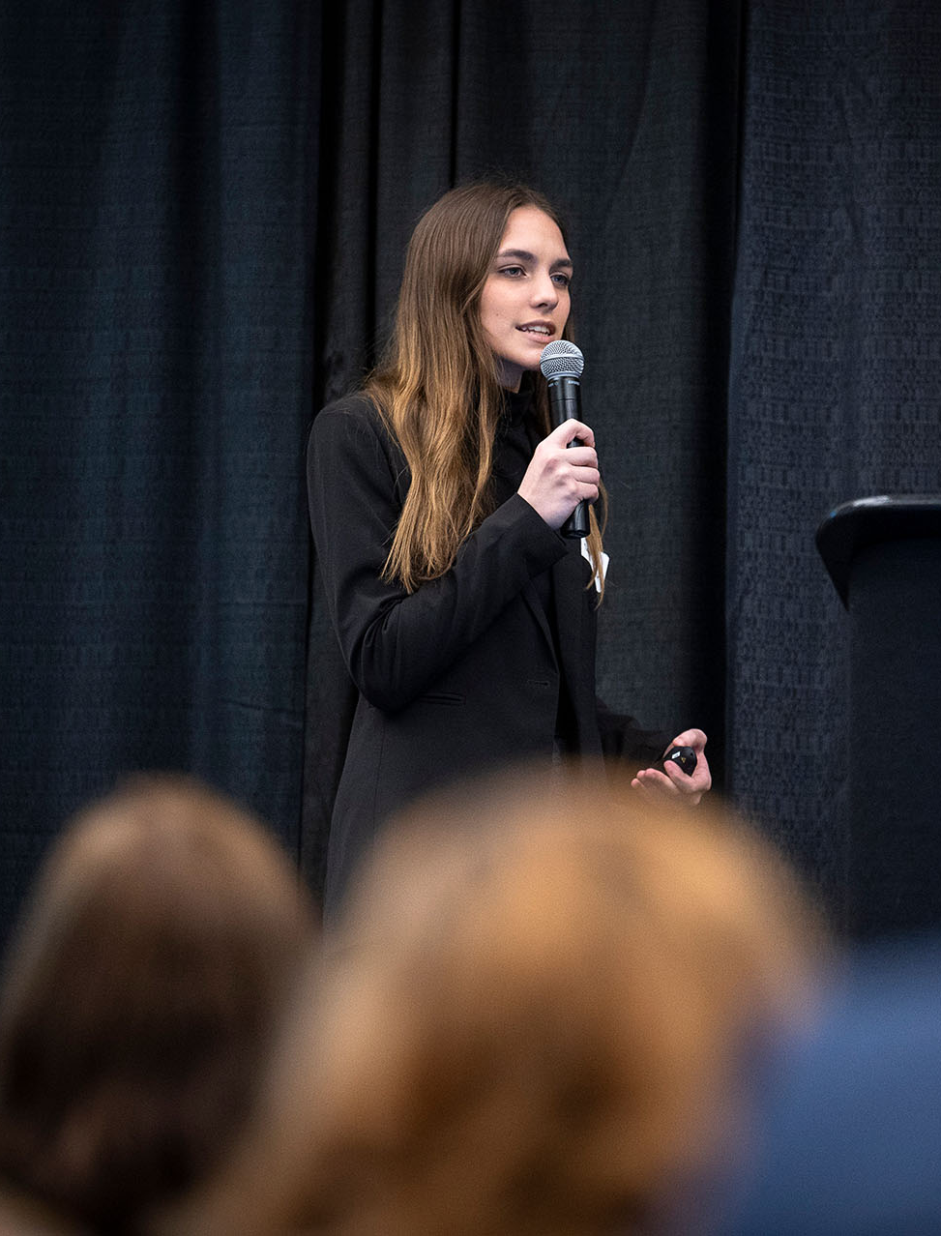
TWO ROUNDS
Round 1: online
January
90-second (max.) pitch video (supplemental
documents accepted)
February
iCorps Training (3 weeks)
March
Workshops/ Pitch Prep
Round 2 (finals): in-person
April
Final Presentation + Q&A
IGNITEWV

Slide 5


PICK YOUR TRACK
TRACK 1:
Main Street
TRACK 2:
Tech and Innovation
The Main Street track focuses on traditional, well-established types of businesses that often have a local or community-oriented presence. These businesses typically serve a specific geographical area and have a tangible physical presence, either as brick-and-mortar establishments or through e-commerce platforms.
The Tech and Innovation track focuses on businesses that are innovative and technology driven. They are scalable business ideas that have the potential for rapid growth. These ideas forge the path and set new standards through their cutting-edge solutions.
Brick-and-Mortar Store
E-Commerce Business
An App
Sustainability Innovations
IGNITEWV

Slide 6
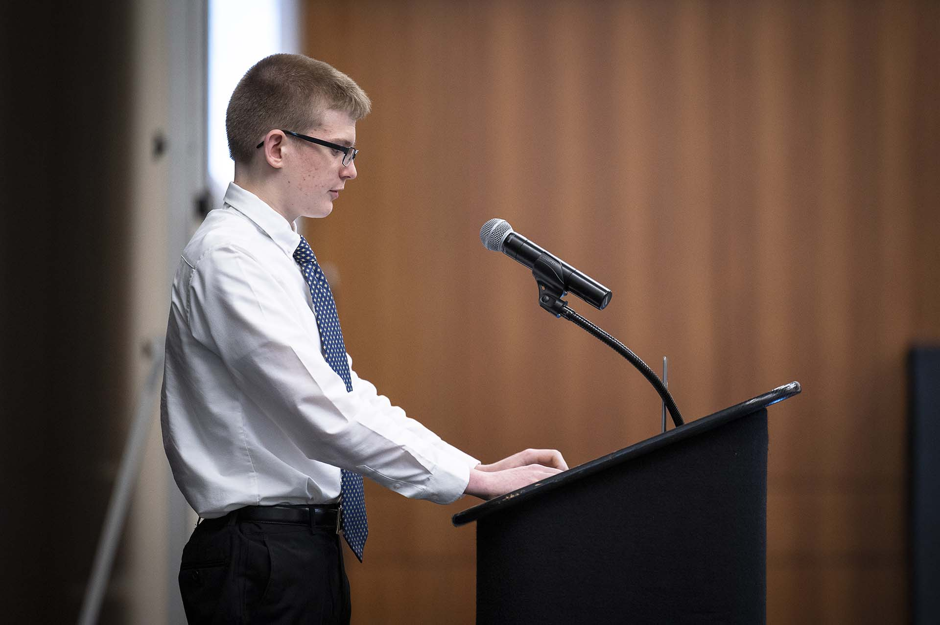
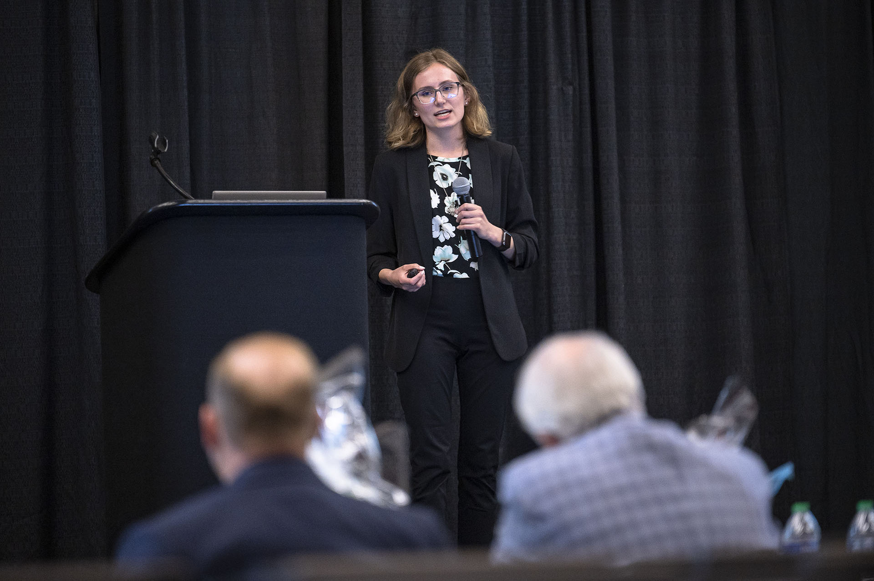
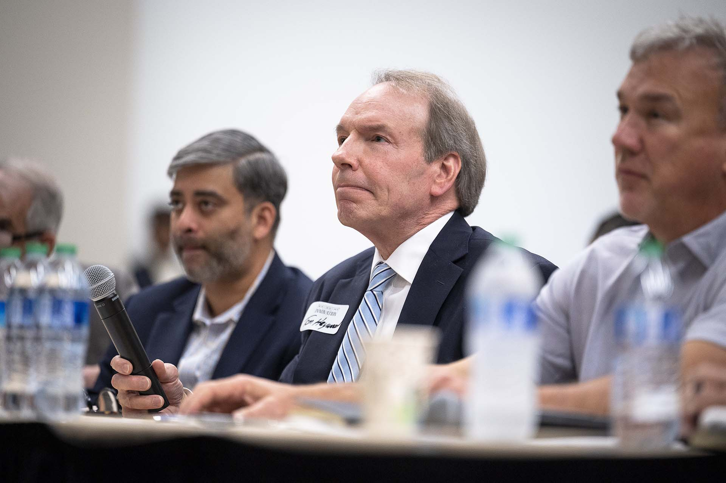
ROUND 2: PITCH TO POTENTIAL INVESTORS
IGNITEWV

Slide 7
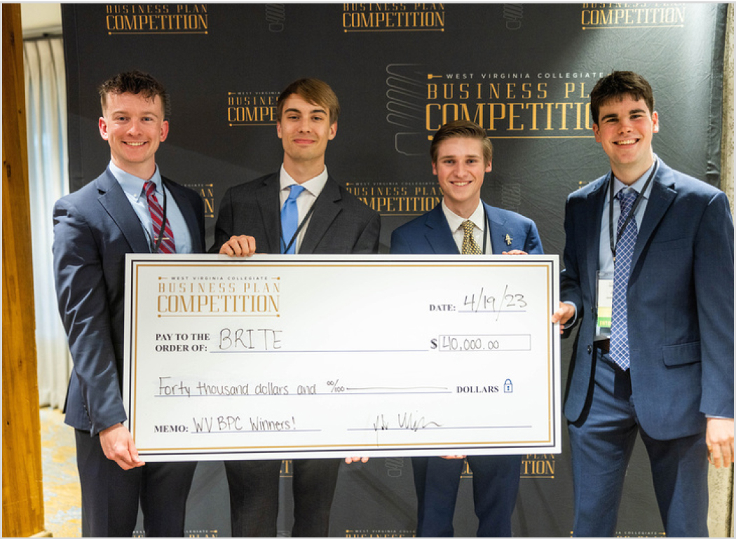

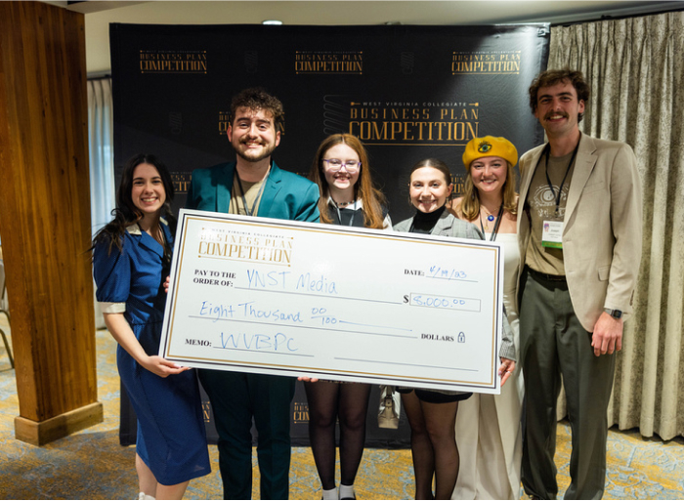


Visit Us Online To Learn More
IgniteWV.com @ignite.wv
IGNITEWV

Slide 8
QUESTIONS
IGNITEWV

